Slide 1
Dental Radiography Systems
BMED434 – Medical Imaging
Awab Abdallah
22700366
Date: 2/6/2025

Slide 2
Introduction
Importance of dental radiography
Types of systems: Intraoral, Extraoral
working principles
device structure
calibration, and safety
Application

Slide 3

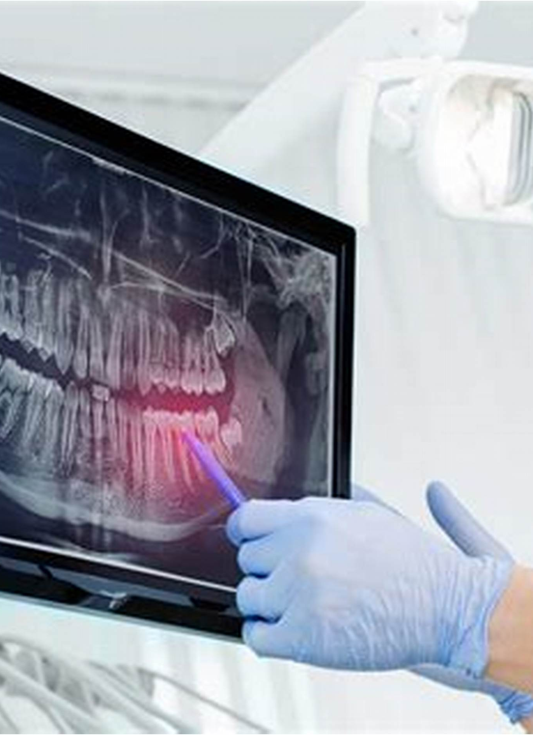
What Is Dental Radiography?
Imaging technique.. teeth, jaw, and oral structures
diagnosis of decay, infection, bone loss, and more

Slide 4
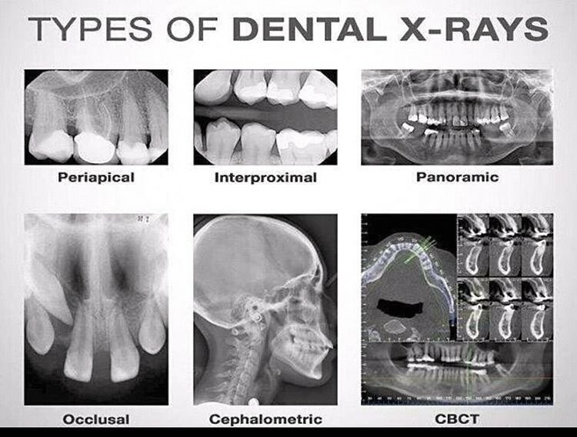

Slide 5
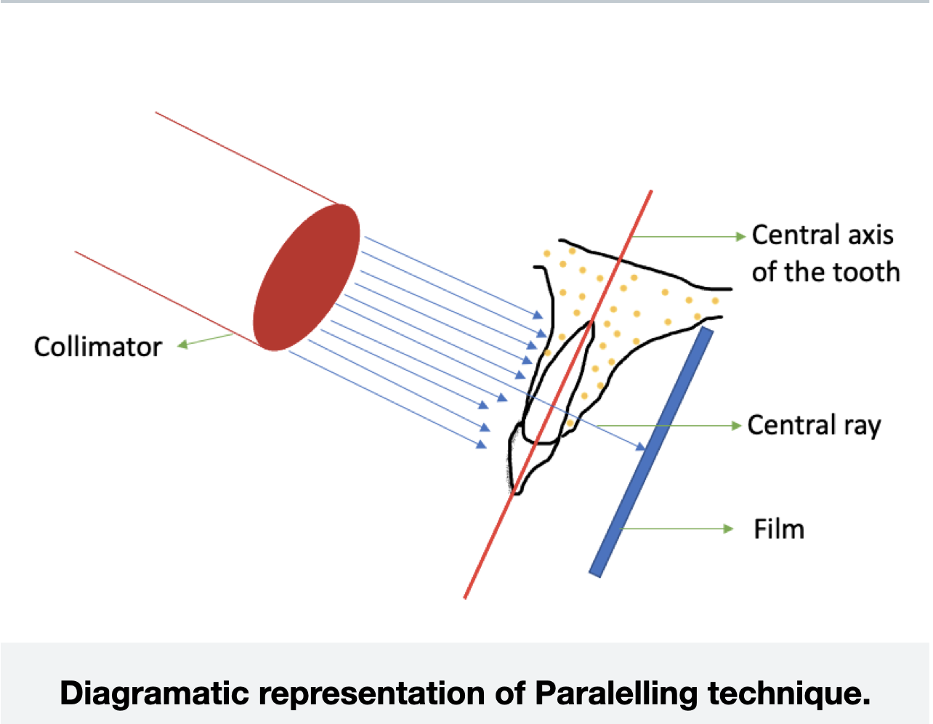
Working principle

Slide 6
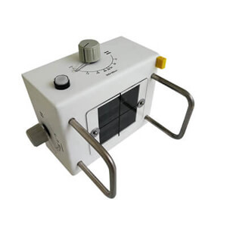
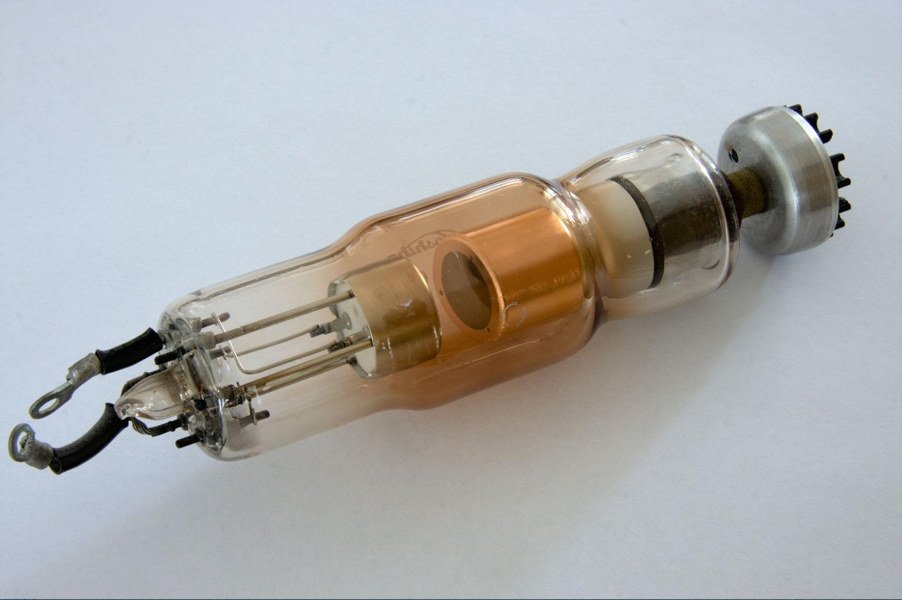
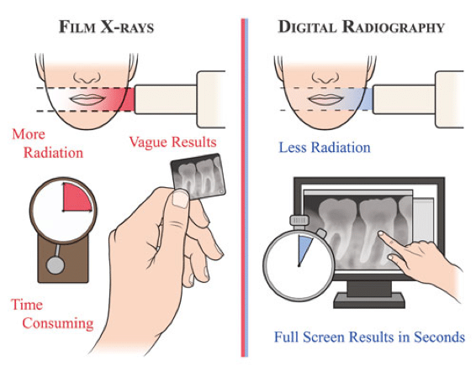
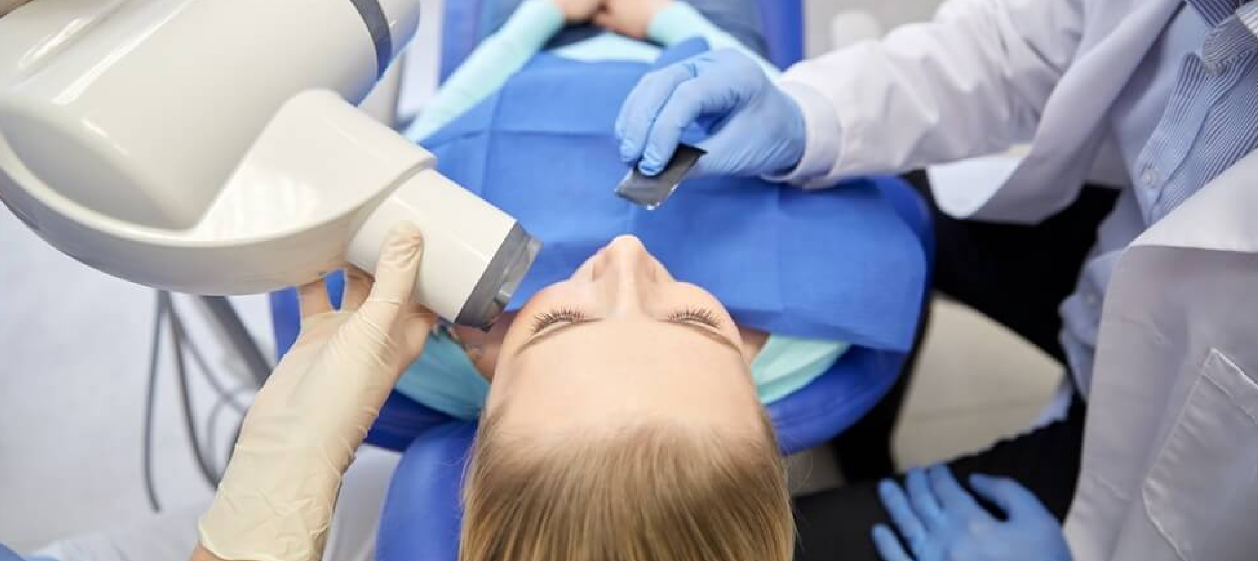
System Components Tube Head Extension Arm Control Panel Image Receptor: Film, digital sensor Embedded Systems

Slide 7
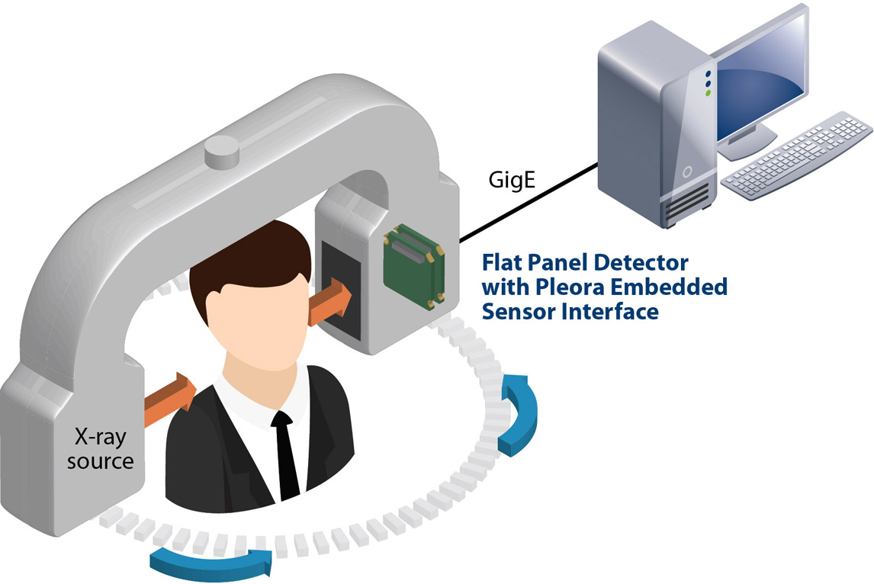

Slide 8
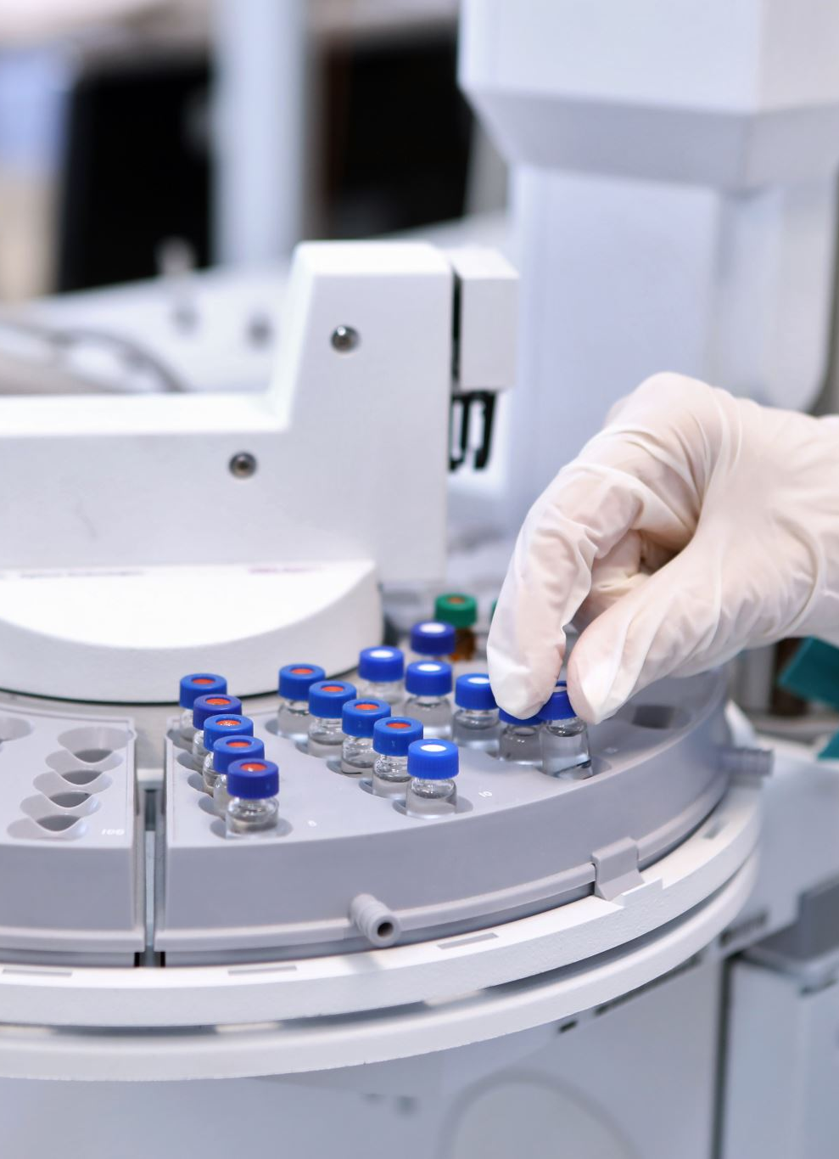
Calibration Methods
Mechanical Calibration: Beam alignment, movement check
Electrical Calibration: kVp, mA, exposure time, dose
Digital Sensor

Slide 9
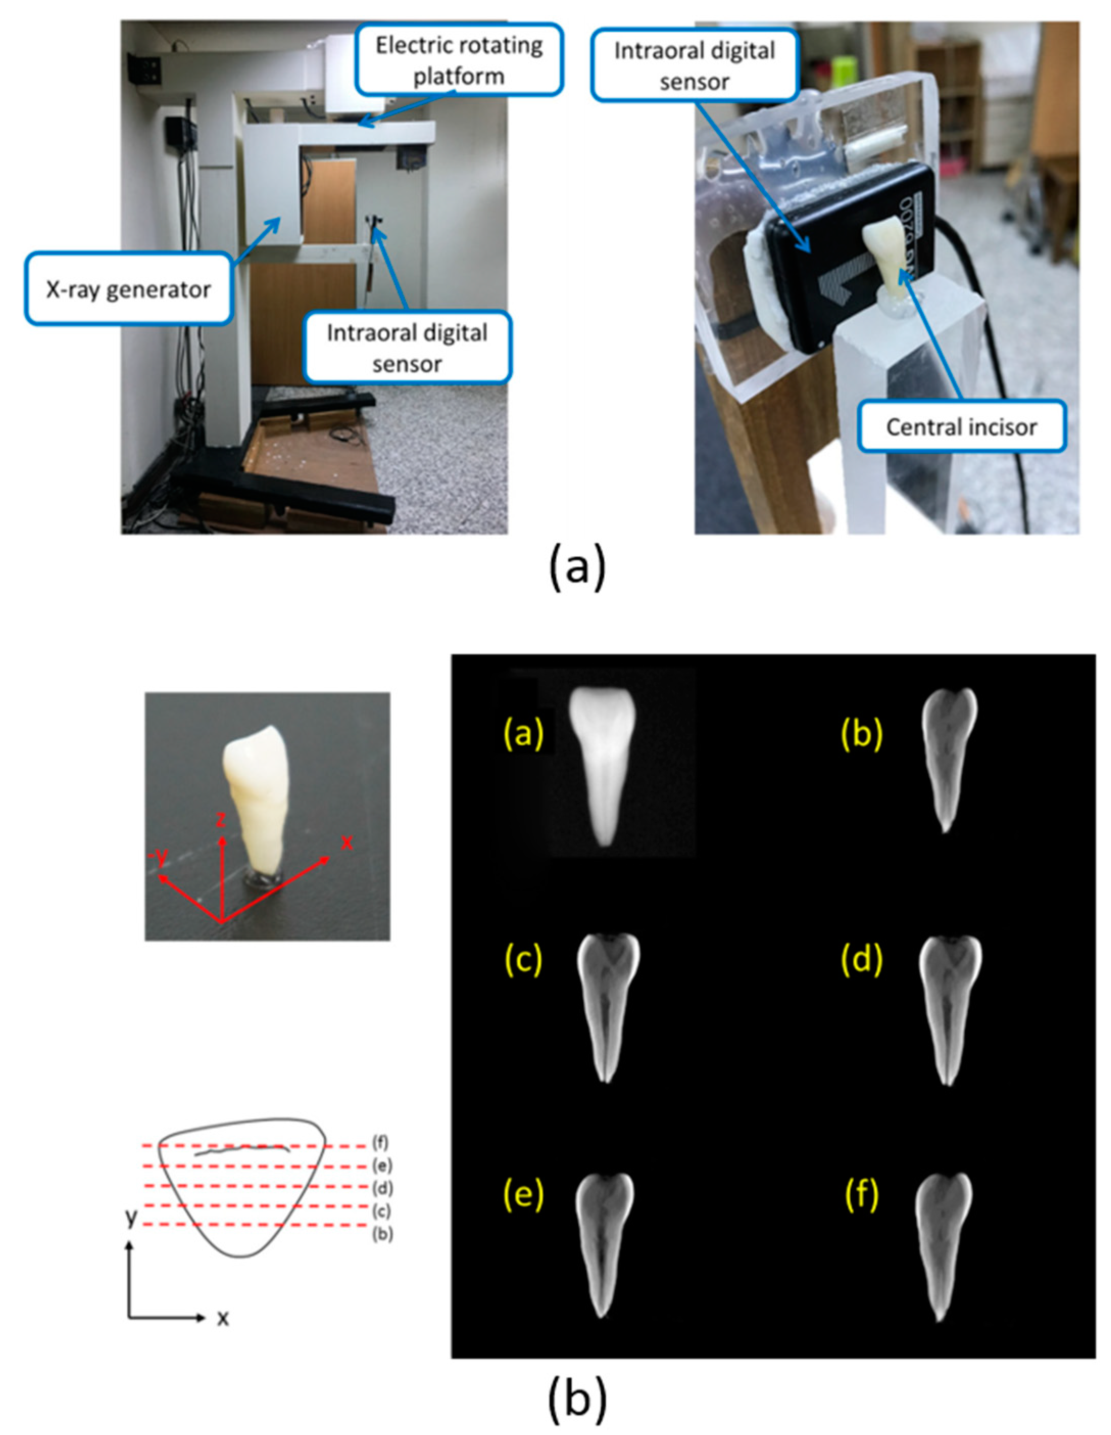

Slide 10
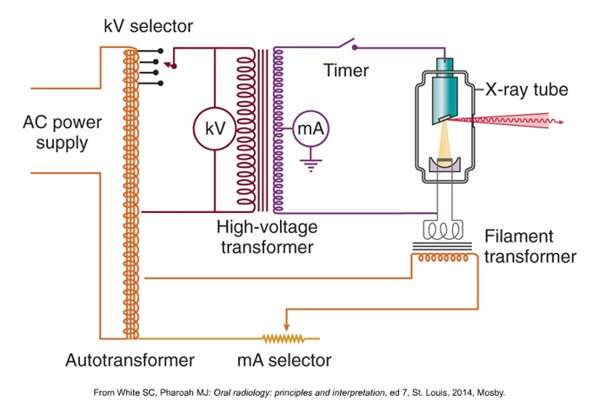
high-voltage circuit low-voltage circuit control circuits

Slide 11
Standards & Regulations
Dental X-ray systems must follow
IEC 60601 ensures the equipment is safe.
IAEA and WHO give guidelines for radiation protection.
Each country , handles licensing and inspections.

Slide 12
Applications
Routine dental exams
Orthodontic planning
surgical guidance
Endodontic (root canal) evaluation

Slide 13
Conclusion
Understanding system components and regulations ensures optimal performance , Continuous training and calibration are essential

Slide 14
References:
Parts of a Dental X-ray Machine | Medikabazaar
https://www.youtube.com/watch?v=YJnVRzq44Hk&ab_channel=Care4Life

Slide 15
Thank you
Any Question ?

